Slide 1

Lecture Presentation
Chapter 7 Periodic Properties of the Elements
James F. Kirby
Quinnipiac University
Hamden, CT

Slide 2
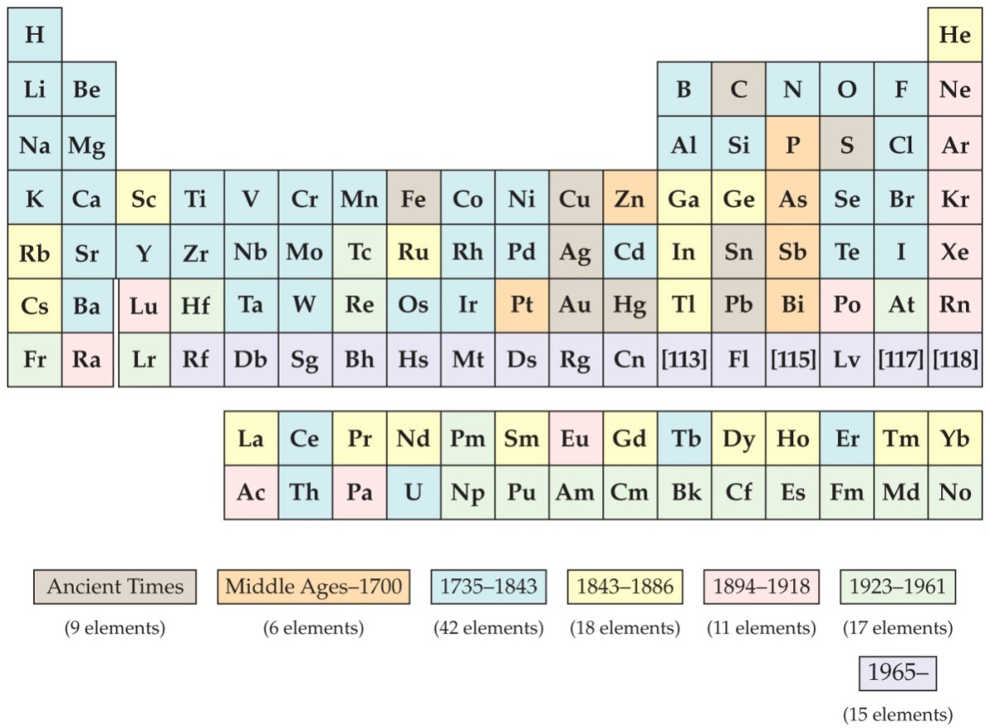
Development of the Periodic Table
Dmitri Mendeleev and Lothar Meyer independently came to the same conclusion about how elements should be grouped.

Slide 3
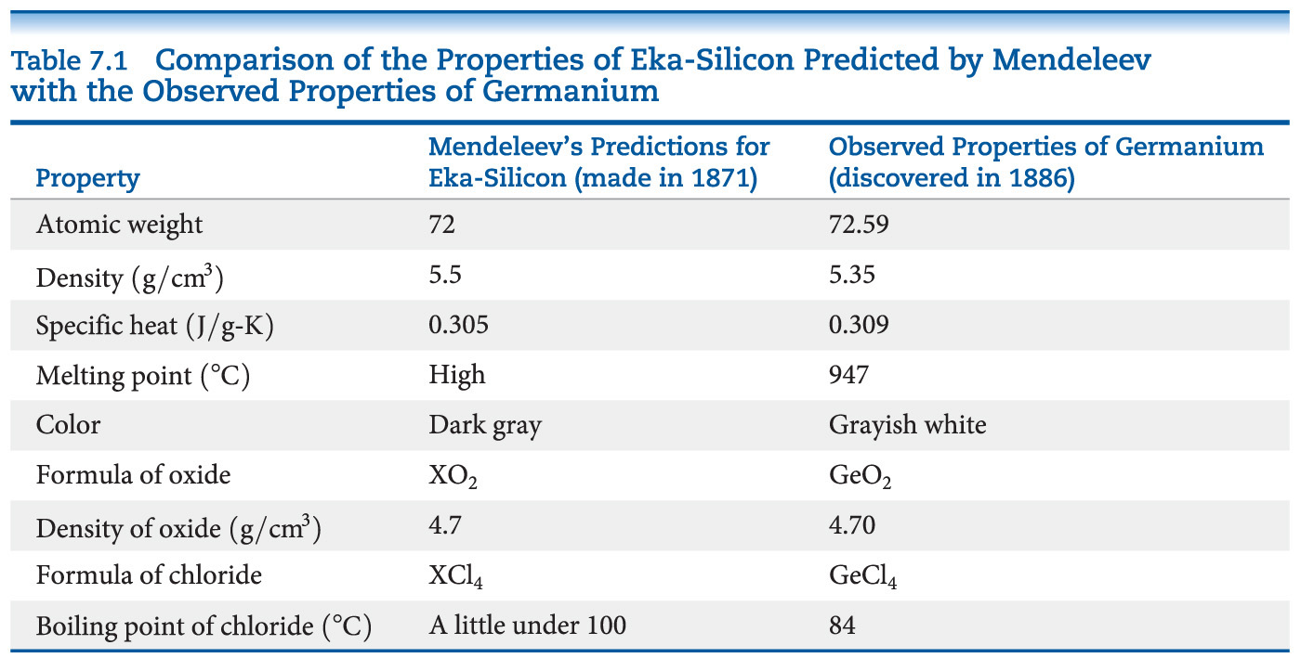
Mendeleev and the Periodic Table
Chemists mostly credit Mendeleev because he also used chemical properties to organize the table and predicted some missing elements and their expected properties, including germanium.

Slide 4
Atomic Number
Mendeleev’s table was based on atomic masses. It was the most fundamental property of elements known at the time.
About 35 years later, the nuclear atom was discovered by Ernest Rutherford.
Henry Moseley developed the concept of atomic number experimentally. The number of protons was considered the basis for the periodic property of elements.

Slide 5
`Periodicity
Periodicity is the repetitive pattern of a property for elements based on atomic number.
The following properties are discussed in this chapter:
Sizes of atoms and ions
Ionization energy
Electron affinity
Chemical property trends
First, we will discuss a fundamental property that leads to many of the trends, effective nuclear charge.

Slide 6
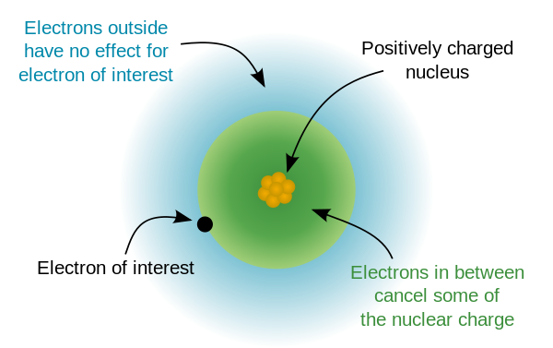
Effective Nuclear Charge
Many properties depend on attractions between valence electrons and the nucleus.
Electrons are both attracted to the nucleus and repelled by other electrons.
The forces an electron experiences depend on both factors.

Slide 7
Effective Nuclear Charge
The effective nuclear charge, Z_{eff}, is found this way:
Z_{eff} = Z − S
where Z is the atomic number and S is a screening constant, usually close to the number of inner electrons.
Effective nuclear charge is a periodic property:
It increases across a period.
It increases (to a less extent) down a group.

Slide 8
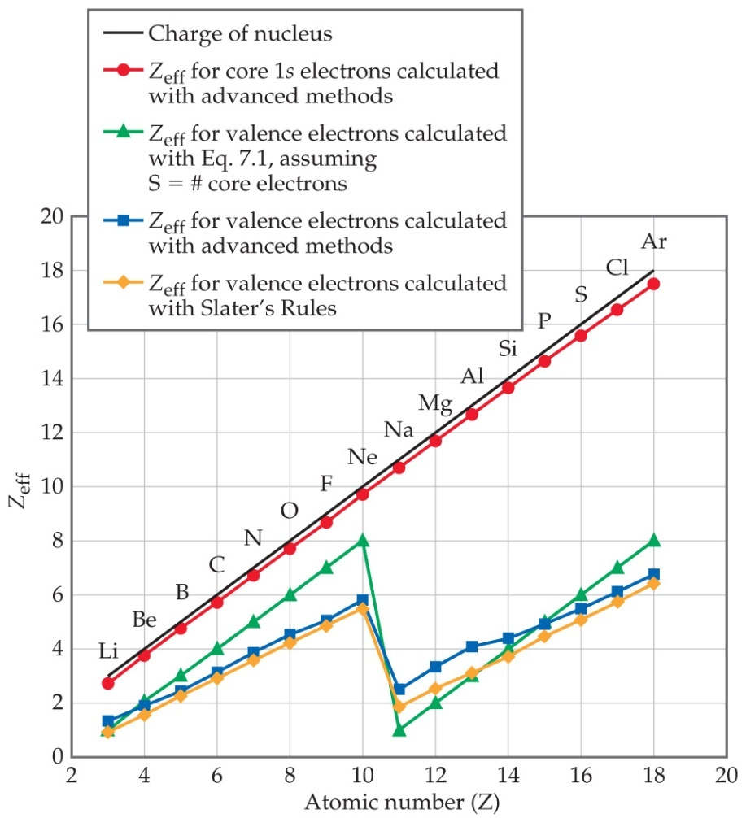
Effective Nuclear Charge Increases across a Period
How effectively screen the nuclear charge
Slater’s Rule:
The screening constant s of an electron is dependent on its location with respect to the electron of interest.
n s = 0.35 (0.30 for 1s electrons)
n-1 s = 0.85
n-2 s = 1

Slide 9
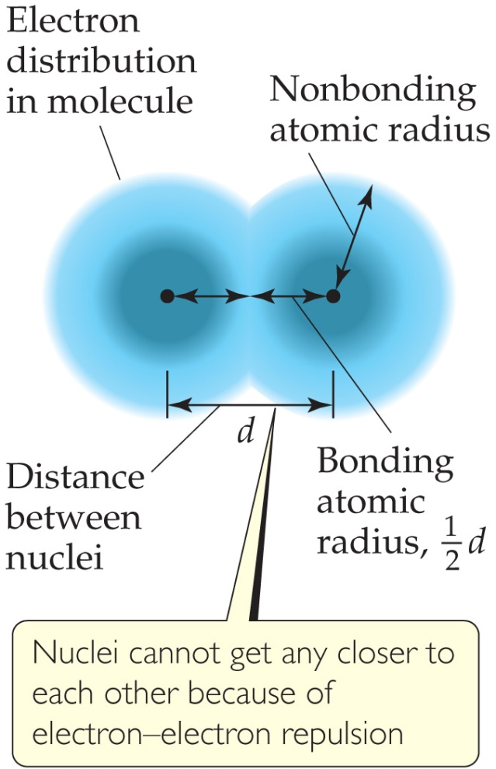
What Is the Size of an Atom?
The nonbonding atomic radius or van der Waals radius is half of the shortest distance separating two nuclei during a collision of atoms.

Slide 10
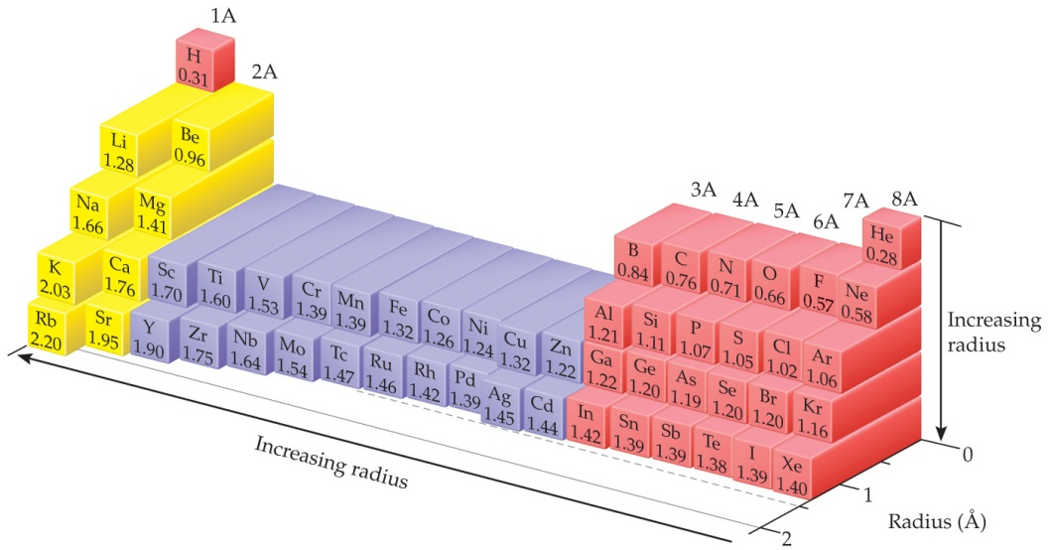
Sizes of Atoms
The bonding atomic radius is half the internuclear distance when atoms are bonded.
The bonding atomic radius tends to
— decrease from left to right across a period (Z_{eff} ↑).
— increase from top to bottom of a group (n ↑).

Slide 11
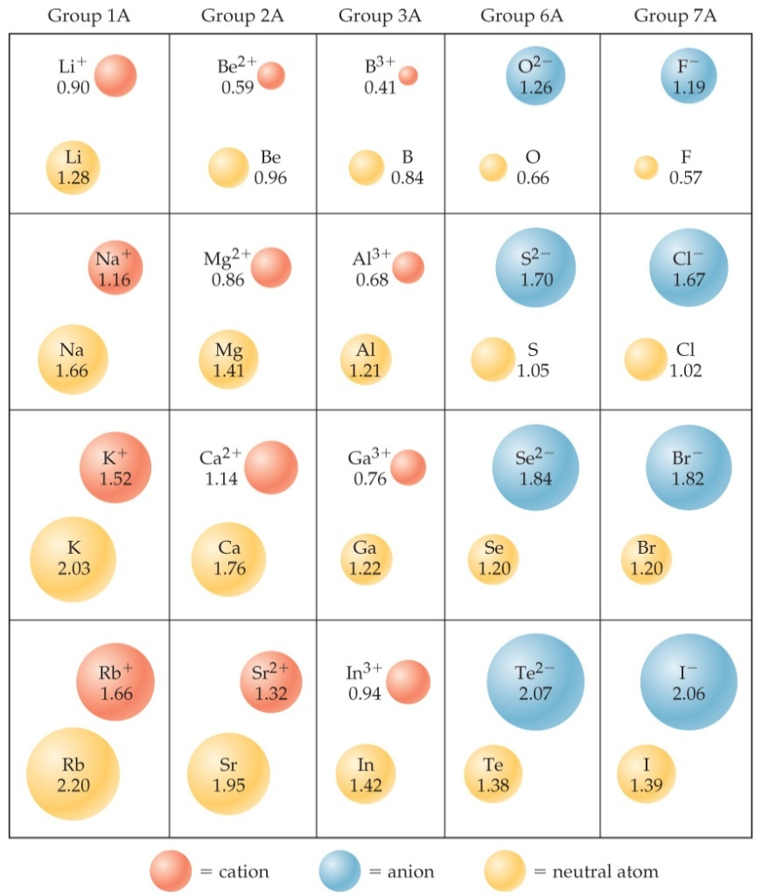
Sizes of Ions
Determined by interatomic distances in ionic compounds
Ionic size depends on
the nuclear charge.
the number of electrons.
the orbitals in which electrons reside.

Slide 12
Sizes of Ions
Cations are smaller than their parent atoms:
The outermost electron is removed and repulsions between electrons are reduced.
Anions are larger than their parent atoms:
Electrons are added and repulsions between electrons are increased.

Slide 13
Size of Ions - Isoelectronic Series
In an isoelectronic series, ions have the same number of electrons.
Ionic size decreases with an increasing nuclear charge.
An Isoelectronic Series (10 electrons)
Note increasing nuclear charge with decreasing ionic radius as atomic number increases
O^{2–} | F– | Na⁺ | Mg²⁺ | Al³⁺
1.26 Å | 1.19 Å | 1.16 Å | 0.86 Å | 0.68 Å

Slide 14
Ionization Energy (I)
The ionization energy is the minimum energy required to remove an electron from the ground state of a gaseous atom or ion.
The first ionization energy is that energy required to remove the first electron.
The second ionization energy is that energy required to remove the second electron, etc.
Note: the higher the ionization energy, the more difficult it is to remove an electron!

Slide 15
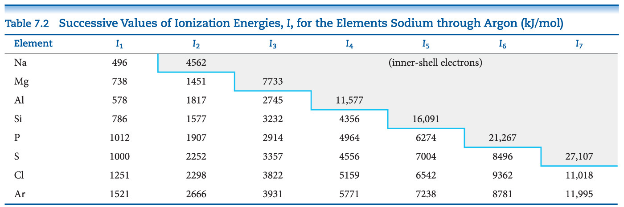
Ionization Energy
It requires more energy to remove each successive electron.
When all valence electrons have been removed, it takes a great deal more energy to remove the next electron.
An sudden increase in the value of I suggests removal of an e from a different and inner shell (e’s are of lower energy; more energy, that is, a higher IE is needed to remove them).

Slide 16
Periodic Trends in First Ionization Energy (I₁)
I₁ generally increases across a period.
I₁ generally decreases down a group.
The s- and p-block elements show a larger range of values for I₁. (The d-block generally increases slowly across the period; the f-block elements show only small variations.)
same principal QN (same #of shells), Z_{eff} increases, size decreases
Increasing principal QN (increasing #of shells), Z_{eff} decreases, size increases

Slide 17
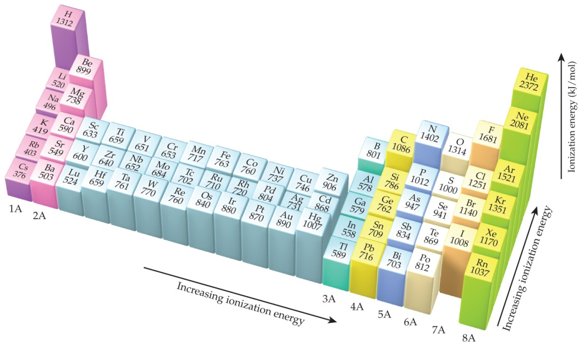
Factors that Influence Ionization Energy
Smaller atoms have higher I values.
I values depend on effective nuclear charge and average distance of the electron from the nucleus.

Slide 18
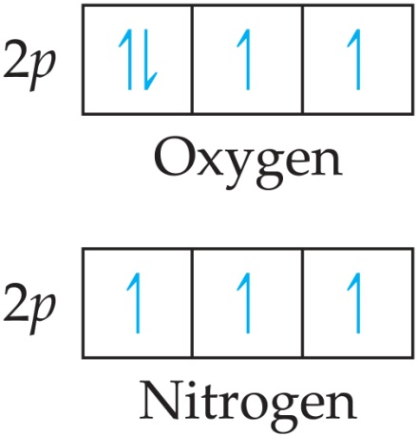
Irregularities in the General Trend
The trend is not followed when the added valence electron in the next element
enters a new sublevel (higher energy sublevel);
Be 1s²2s²2p⁰ versus B 1s²2s²2p¹
is the first electron to pair in one orbital of the sublevel (electron repulsions lower energy).
electronic repulsion
half-filled

Slide 19
Electron Configurations of Ions Cations: The electrons are lost from the highest energy level (largest n value). Li⁺ is 1s² (losing a 2s electron) from 1s²2s¹. Fe²⁺ is 1s²2s²2p⁶3s²3p⁶3d⁶ by losing two 4s e’s from Fe 1s²2s²2p⁶3s²3p⁶4s²3d⁶ (aufbau) Anions: The electron configurations are filled to ns²np⁶; e.g., F– is 1s²2s²2p⁶ by gaining one e in 2p from F 1s²2s²2p⁵.

Slide 20
Electron Affinity
Electron affinity is the energy change accompanying the addition of an electron to a gaseous atom:
Cl + e⁻ ⎯⎯→ Cl⁻
It is typically exothermic, so, for most elements, it is negative (after all, there is the Z_{eff} – attraction by the necleus.)

Slide 21
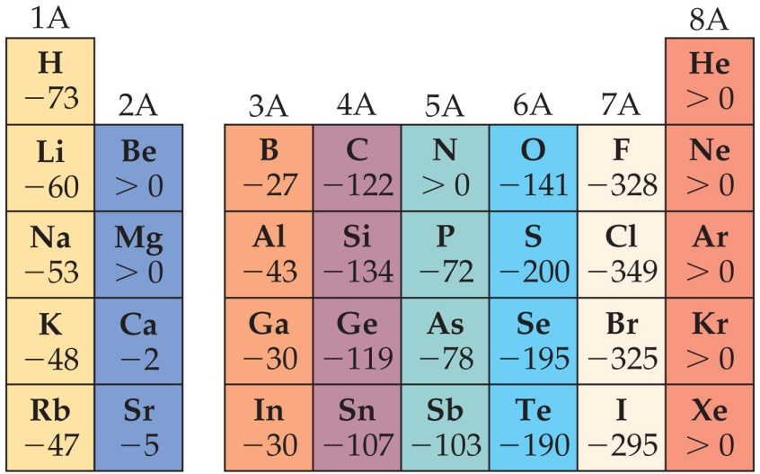
General Trend in Electron Affinity
Not much change in a group.
Across a period, it generally increases (why?) but with three notable exceptions include the following:
Group 2A: s sublevel is full!
Group 5A: p sublevel is half-full!
Group 8A: p sublevel is full!
Note: the electron affinity for many of these elements is positive (X– is unstable).

Slide 22
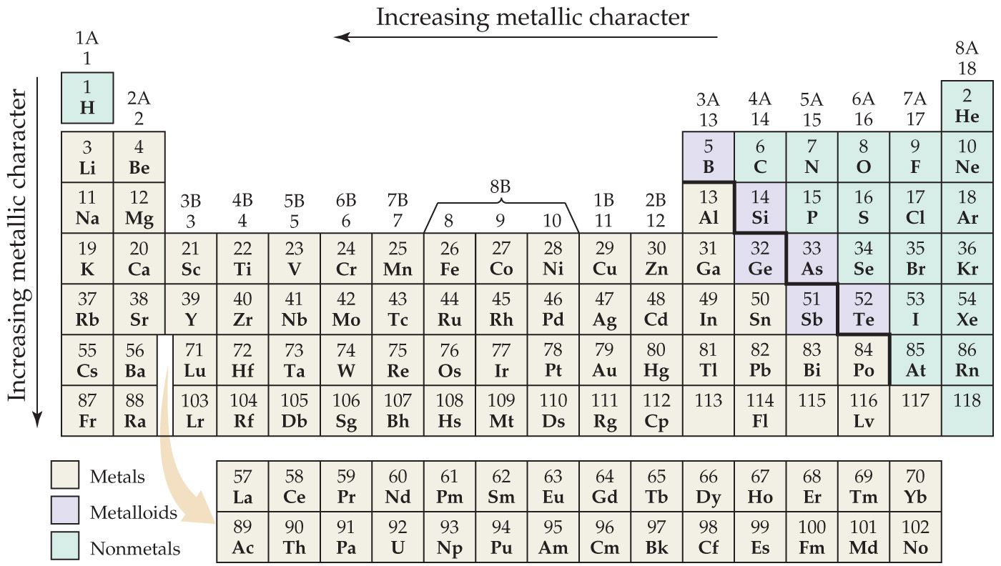
Metal, Nonmetals, and Metalloids

Slide 23
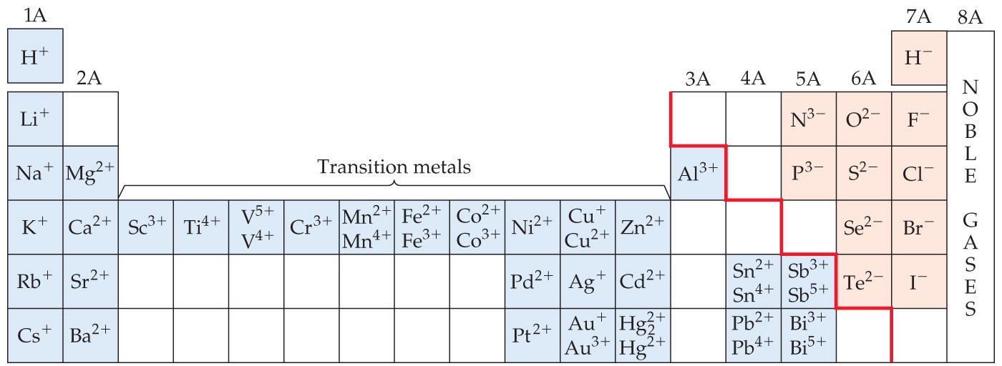
Metals Differ from Nonmetals
Metals tend to form cations.
Nonmetals tend to form anions.
Ionic compounds

Slide 24
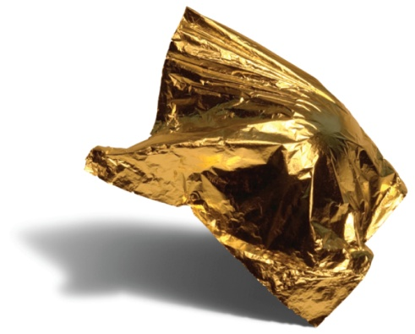
Metals
Most of the elements in nature are metals (~ 85%).
Properties of metals:
Shiny luster
Conduct heat and electricity
Malleable and ductile
Solids at room temperature (except mercury)
Low ionization energies/form cations easily

Slide 25
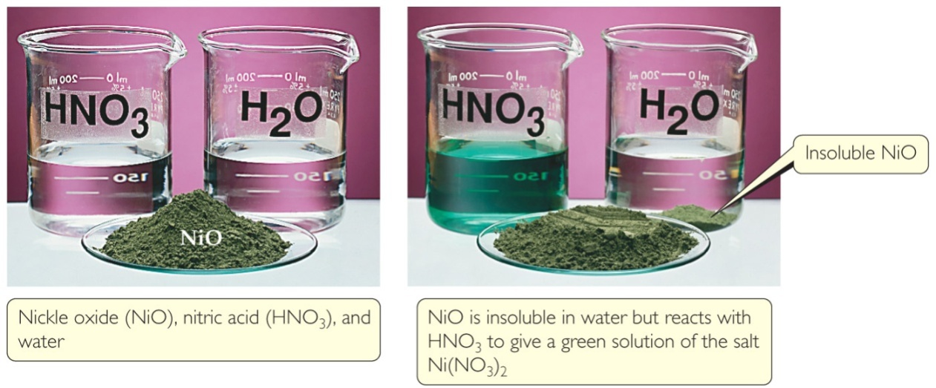
Metal Chemistry
Compounds formed between metals and nonmetals tend to be ionic.
Metal oxides tend to be basic (Li₂O, MgO).

Slide 26
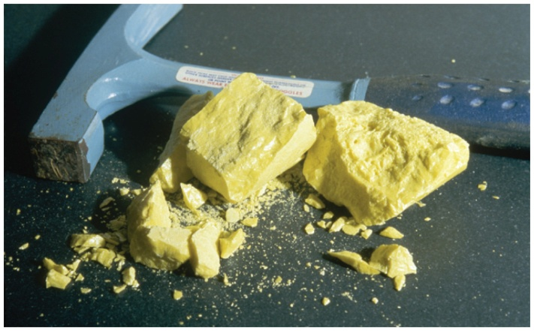
Nonmetals
Nonmetals are found on the right hand side of the periodic table.
Properties of nonmetals include the following:
Solid, liquid, or gas (depends on element)
Solids are dull, brittle, poor conductors
Large negative electronegativity/form anions readily

Slide 27
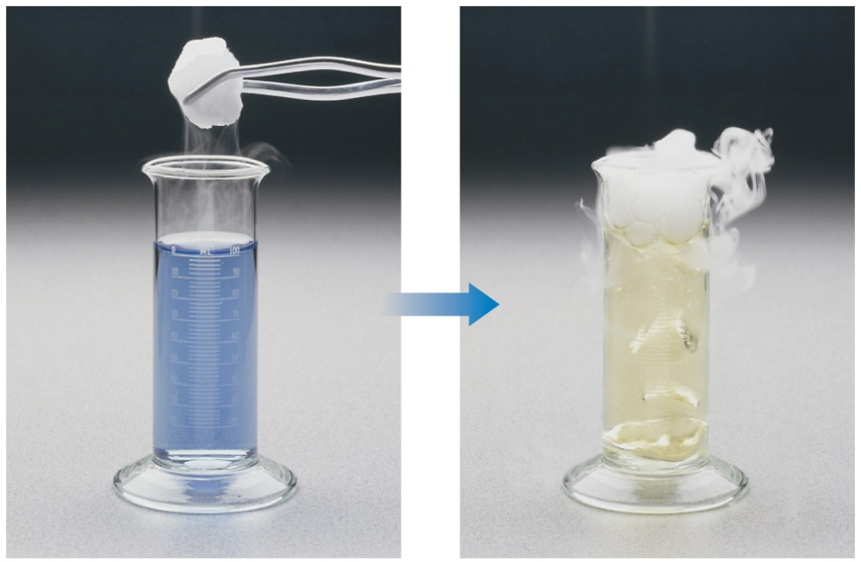
Nonmetal Chemistry
Substances containing only nonmetals are molecular (covalent) compounds.
Most nonmetal oxides are acidic （N₂O₅, SO₃, CO₂).

Slide 28
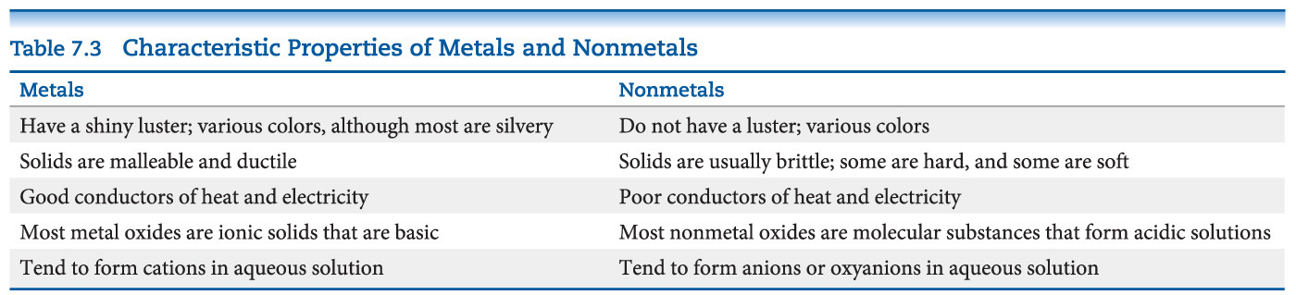
Recap of a Comparison of the Properties of Metals and Nonmetals

Slide 29
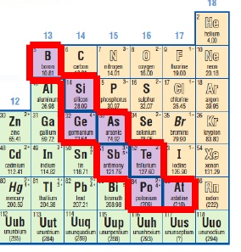
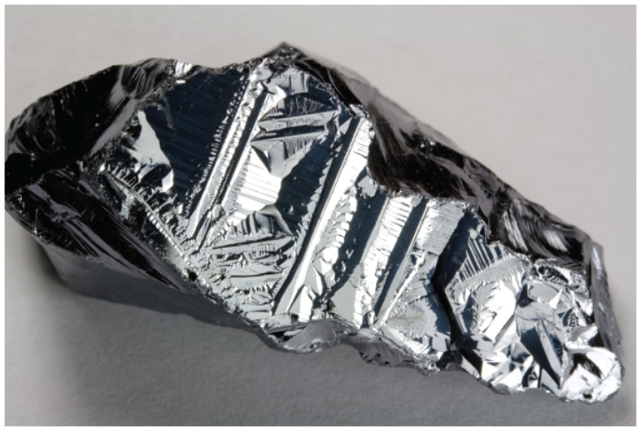
Metalloids (all in p-block)
Metalloids have some characteristics of metals and some of nonmetals.
Several metalloids are electrical semiconductors (computer chips).
Commonly accepted 6: B, Si/Ge, As/Sb, Te

Slide 30
Group Trends
Elements in a group have similar properties.
Trends also exist within groups.
Groups Compared:
Group 1A: The Alkali Metals
Group 2A: The Alkaline Earth Metals
Group 6A: The Oxygen Group
Group 7A: The Halogens
Group 8A: The Noble Gases

Slide 31
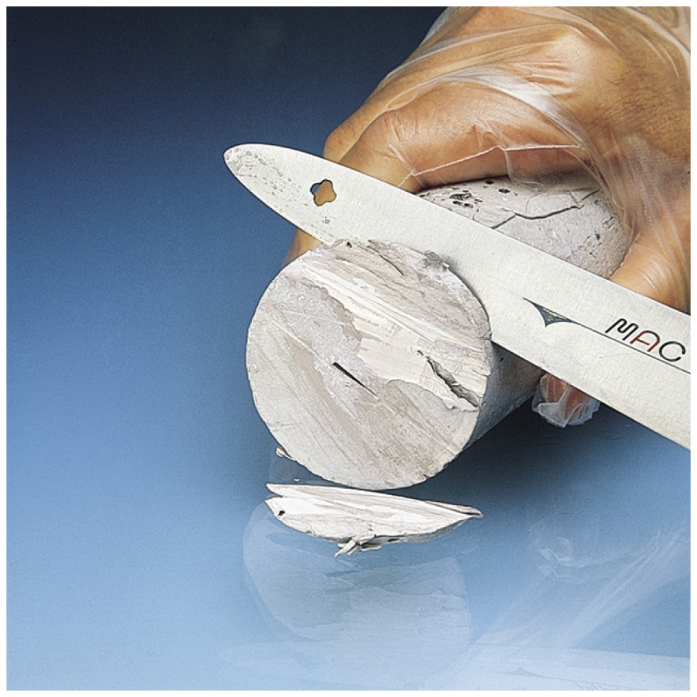
Alkali Metals
Alkali metals are soft, metallic solids.
They are found only in compounds in nature, not in their elemental forms.
Typical metallic properties (luster, conductivity) are seen in them.

Slide 32
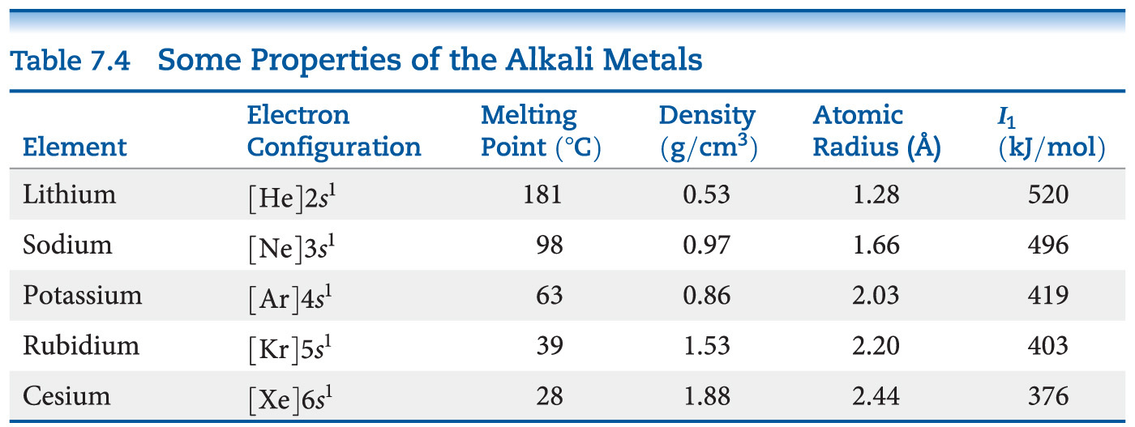
Alkali Metal Properties
They have low densities and melting points.
They also have low ionization energies.

Slide 33
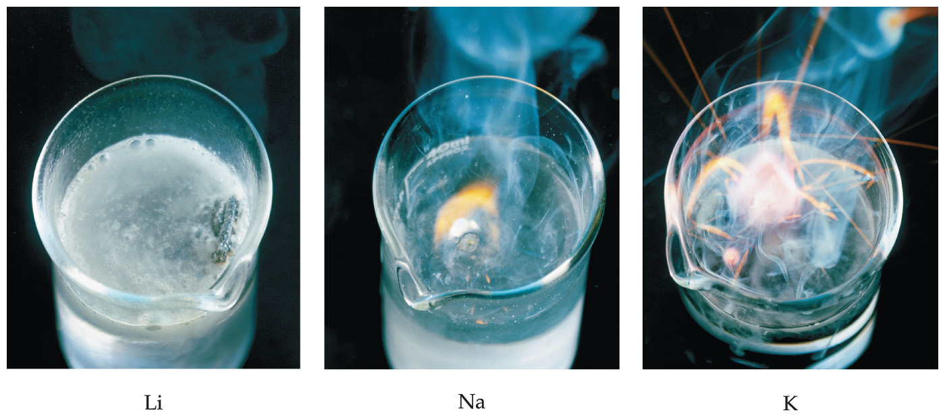
Alkali Metal Chemistry
Their reactions with water are (in)famously exothermic.

Slide 34
Differences in Alkali Metal Chemistry
Lithium reacts with oxygen to make an oxide:
4 Li + O₂ ⎯⎯→ 2 Li₂O
Sodium reacts with oxygen to form a peroxide:
2 Na + O₂ ⎯⎯→ Na₂O₂
K, Rb, and Cs also form superoxides:
M + O₂ ⎯⎯→ MO₂

Slide 35
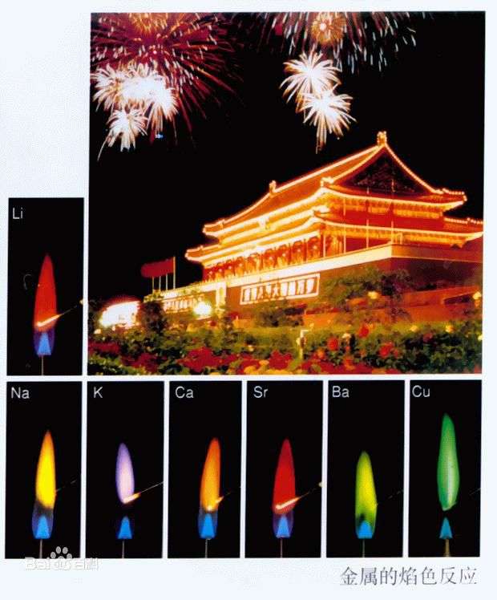
Flame Tests (atomic emission spectrometry)
Qualitative tests for alkali metals include their characteristic (emission) colors in flames.

Slide 36
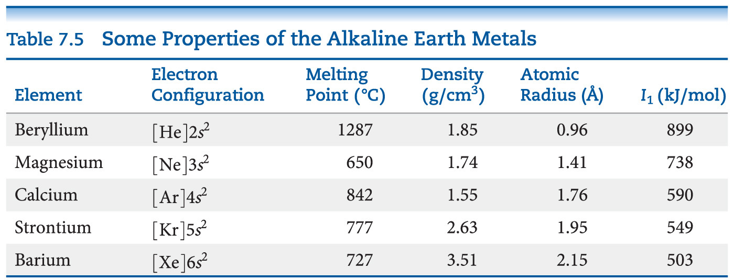
Alkaline Earth Metals—Compare to Alkali Metals
Alkaline earth metals have higher densities and melting points than alkali metals.
Their ionization energies are low, but not as low as those of alkali metals.

Slide 37
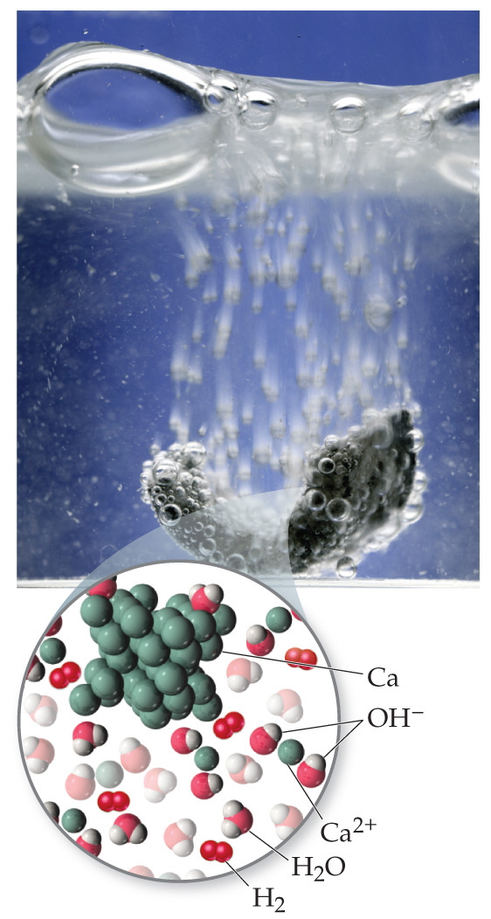
Alkaline Earth Metals
Beryllium does not react with water, and magnesium reacts only with steam, but the other alkaline earth metals react readily with water.
Reactivity tends to increase as you go down the group.

Slide 38
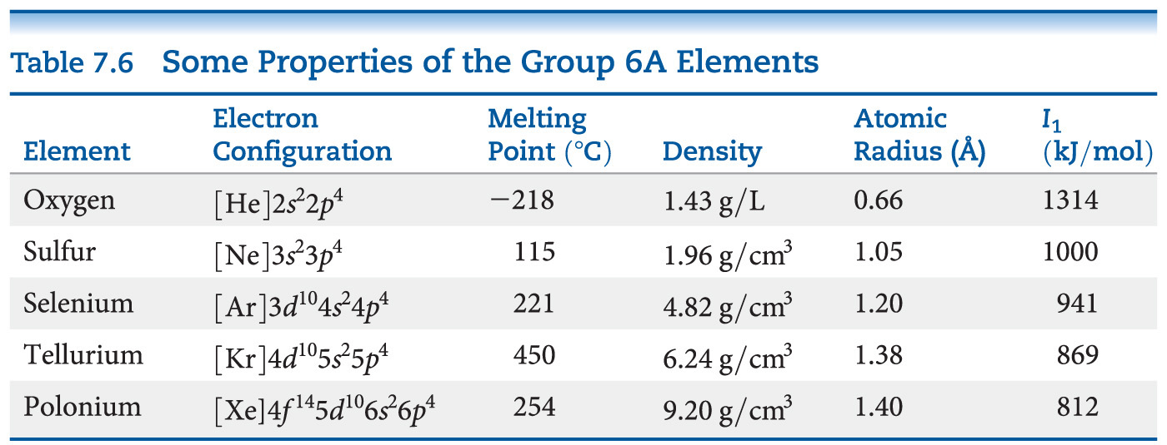
Group 6A—Increasing in Metallic Character down the Group
Oxygen, sulfur, and selenium (Se) are nonmetals.
Tellurium (Te) is a metalloid.
The radioactive polonium is a metal.

Slide 39
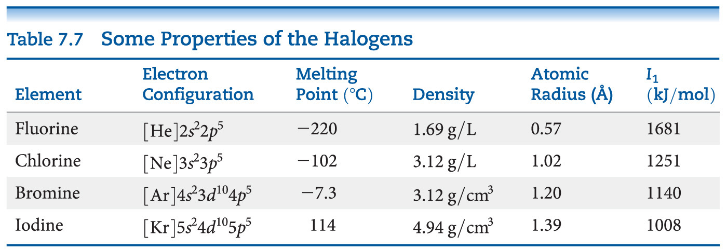
Group 7A—Halogens
The halogens are typical nonmetals.
They have highly negative electron affinities, so they exist as anions in nature.
They react directly with metals to form metal halides.

Slide 40
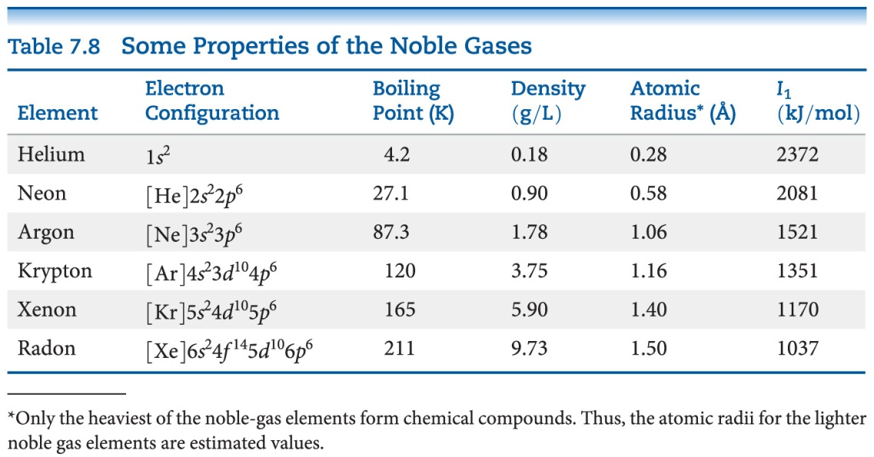
Group 8A—Noble Gases
The noble gases have very large ionization energies.
Their electron affinities are positive (can’t form stable anions).
Therefore, they are relatively unreactive.
They are found as monatomic gases (less interactive).

